Slide 1
The Ultimate Survival Guide to Operating Restaurants
Las Vegas Edition

Slide 2
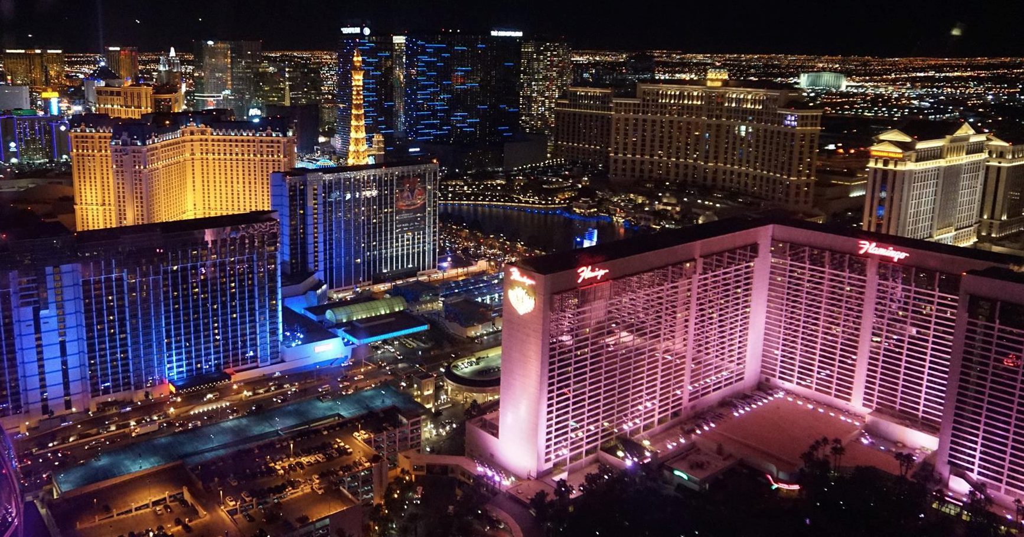
Welcome to Las Vegas!

Slide 3
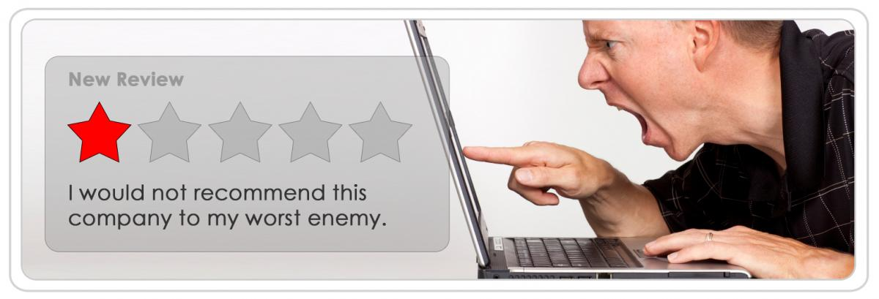

Impact of Yelp Review

Slide 4
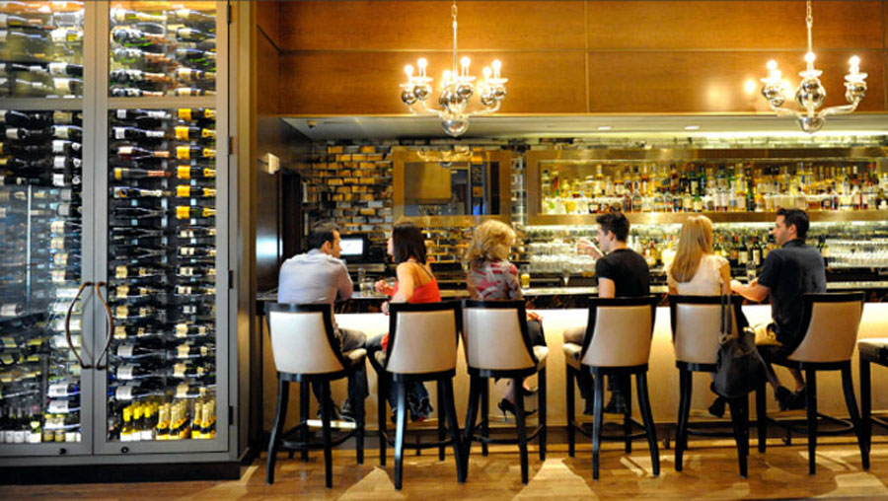
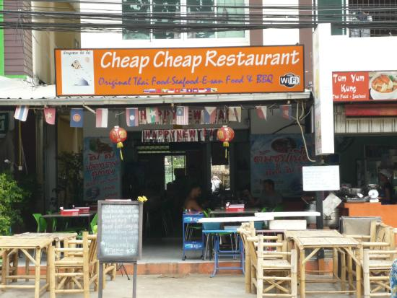
Upscale vs Cheap Cheap

Slide 5
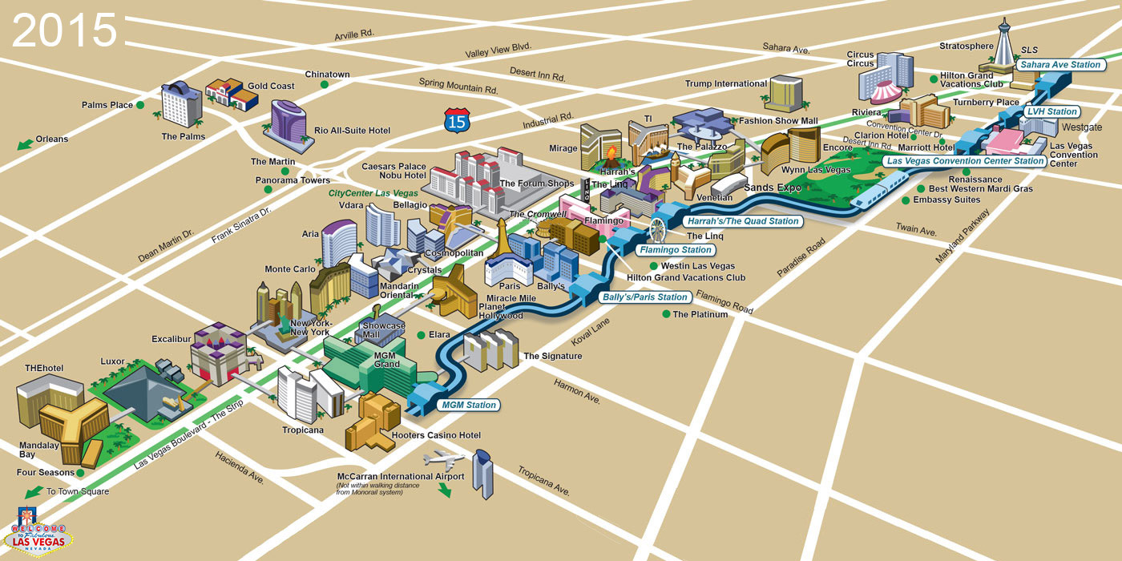
Does Location Matter?

Slide 6
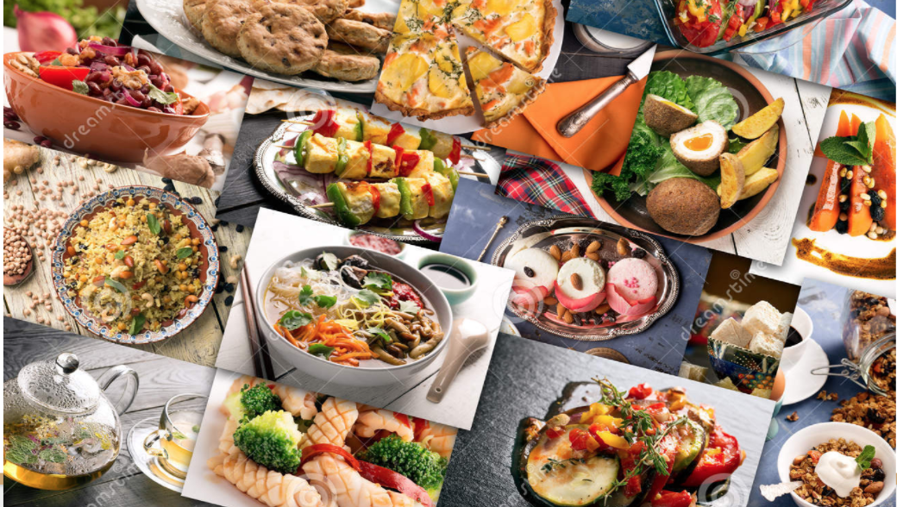
Types of Meal and Cuisine, and More...

Slide 7
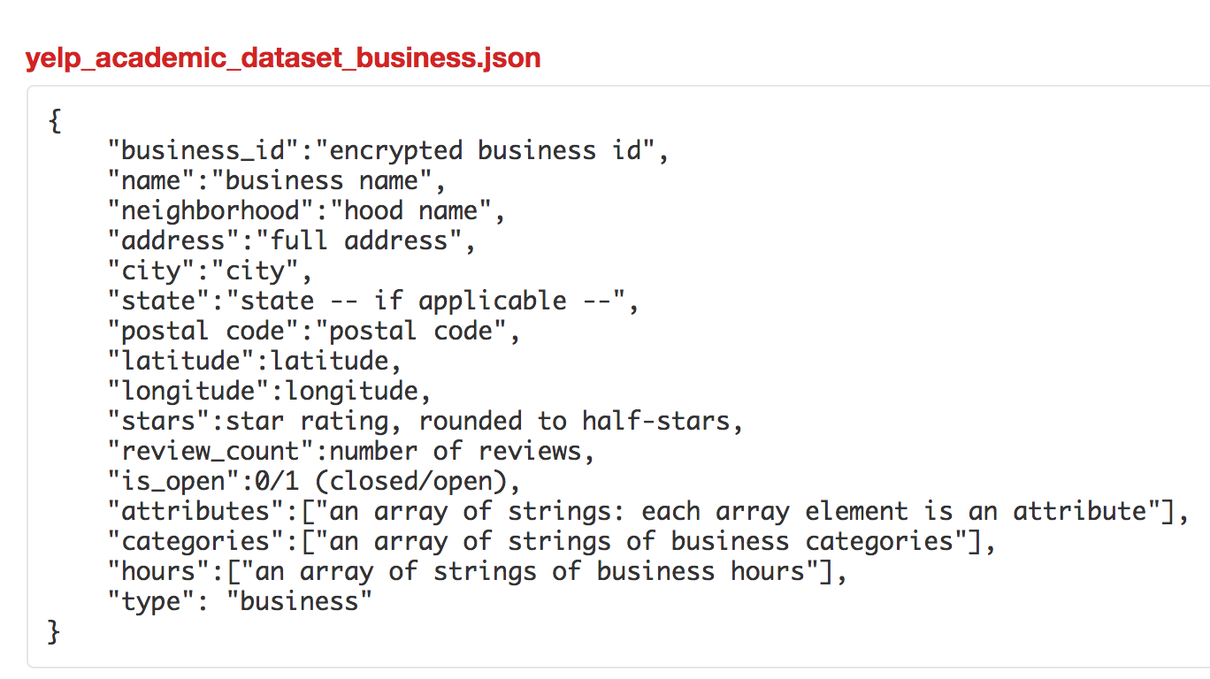
Data Collection
Yelp Dataset Challenge
Converted from Json file
Limited to restaurants in Las Vegas
5,431 data points

Slide 8
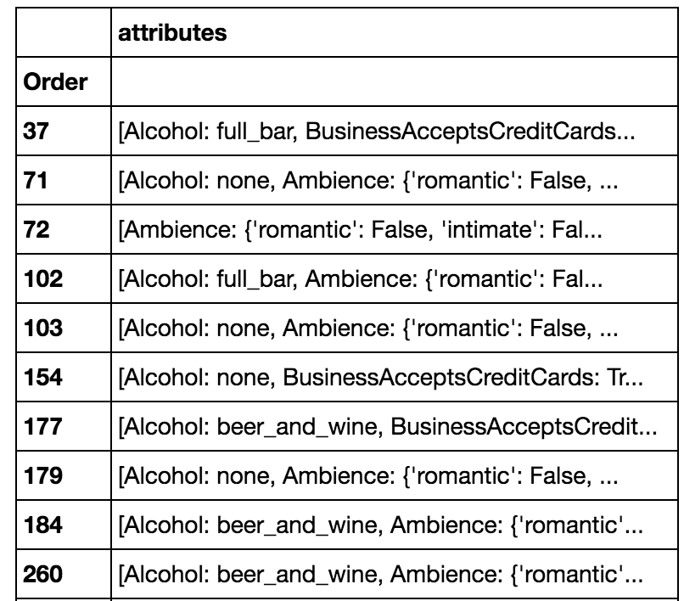
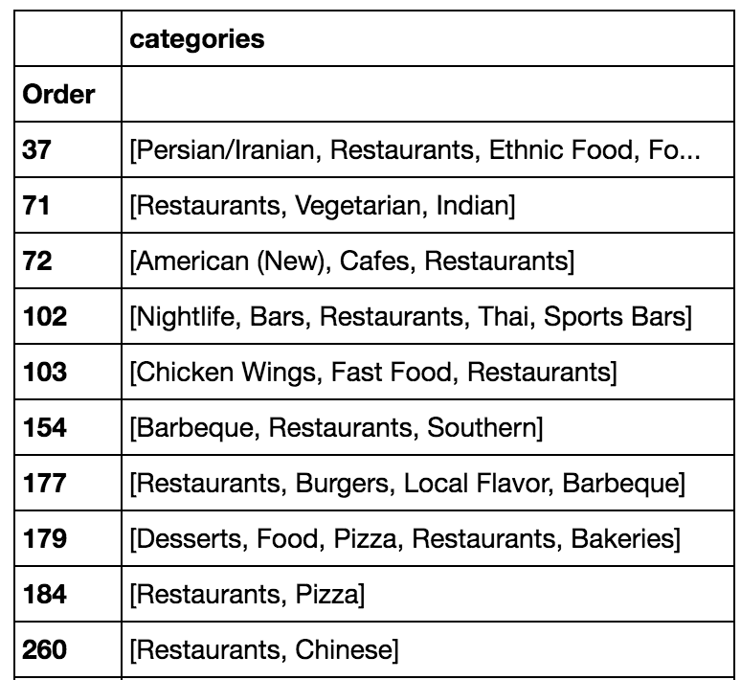
Feature Engineering

Slide 9
Feature Engineering
For columns containing lists of lists and dictionaries
created columns for common items
iterated through rows and appended ‘1’ if row contains the item
Replaced missing categorical data with mode
Scaled with Standard Scalar

Slide 10
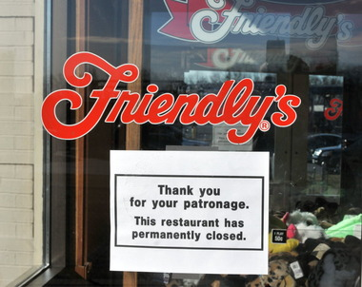
Target Variable
Binary variable ‘is_open’
1 if the restaurant is operating
0 if the restaurant is permanently closed
3,849 open, 1,582 closed

Slide 11
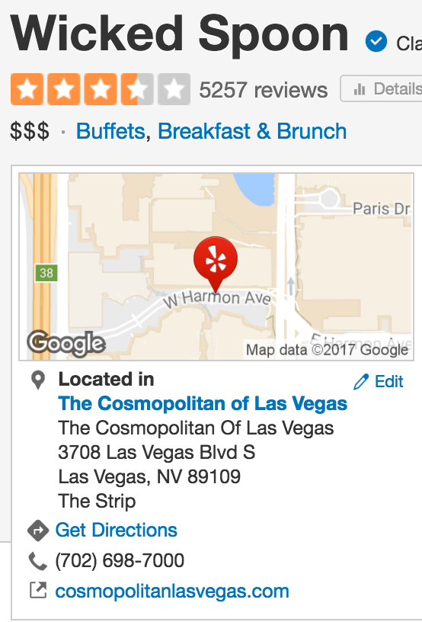
Features - Numeric
Review counts
Yelp stars
Price range

Slide 12
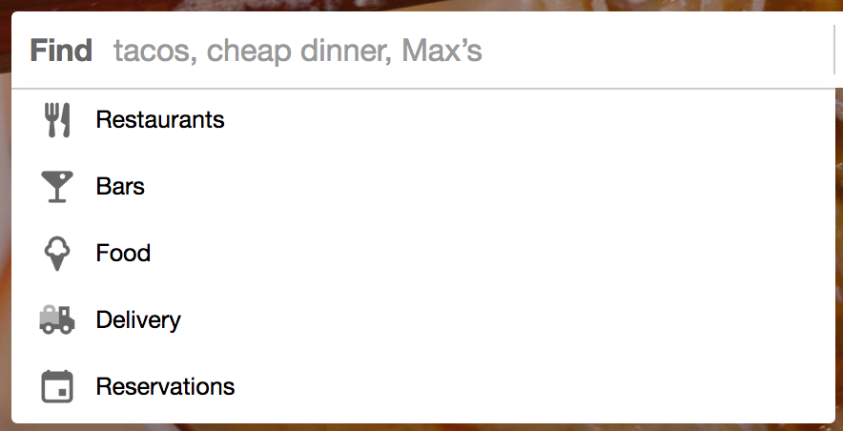
Features - Categorical
Type of Meal
Dessert
Late night
Lunch
Dinner
Breakfast

Slide 13
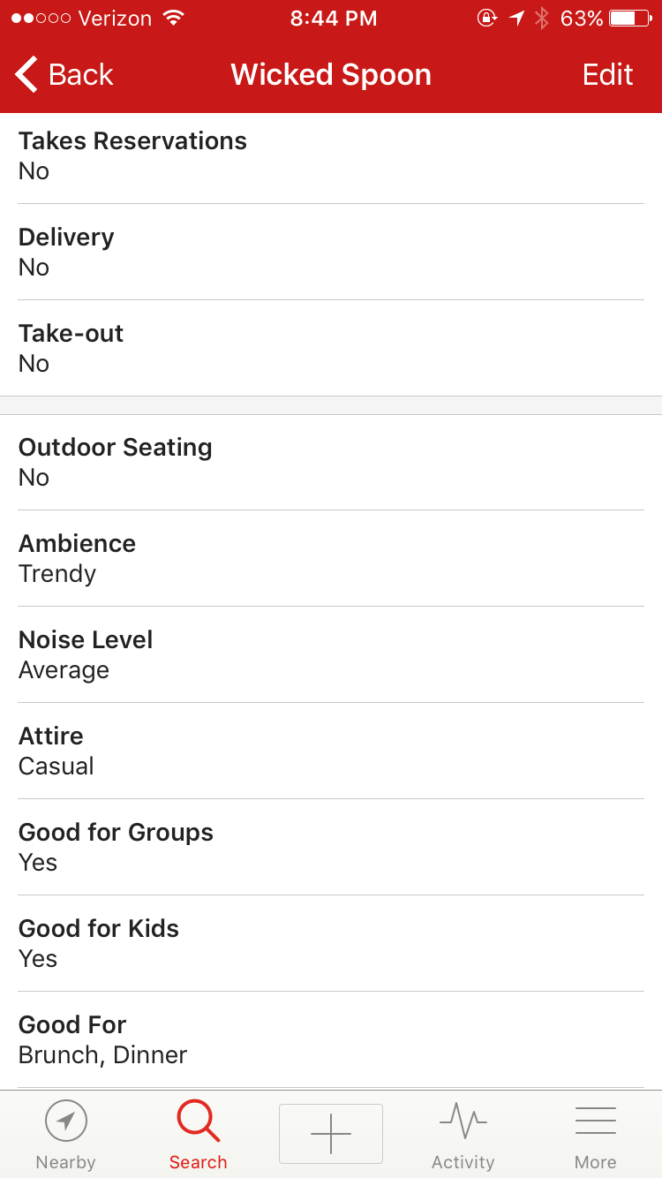
Sample Page from Yelp
(mobile version)

Slide 14
Features - Categorical
Outdoor Seating
Delivery
Alcohol
Has TV
Noise Level
Wifi (no, free or paid)
Ambience (casual or not)
Restaurant Attributes
Downtown
Good For Groups
Take Out
Good For Kids
Attire (casual or not)
Reservations

Slide 15
Features - Categorical
Chinese
Mexican
Japanese
Italian
Sandwiches
Seafood
Breakfast & Brunch
Restaurant Categories
Nightlife
Bars
Fast Food
Burgers
Pizza
American

Slide 16
Building Classifiers
Splitted scaled data into train and test set
GridSearch cross validated models to tune parameters
Logistic Regression
K Nearest Neighbors
Gaussian and Bernoulli Naive Bayes
Support Vector Machine
Decision Tree and Random Forest

Slide 17
Evaluating Classifiers
Compared in sample and out of sample performance
Avoid overfitting
Compared out of sample accuracy score of the best model from GridSearch for each algorithm

Slide 18
And the winners are...

Slide 19


Slide 20
Best Classifiers
Logistic Regression (L1)
SVM
KNN

Slide 21
Ensemble
Used Voting Classifier to combine these 3 algorithms and smooth out some individual variances
 | Dummy Classifier | Voting Classifier
Accuracy | 61% | 75%
Recall | 74% | 95%

Slide 22
Voting Classifier in Work
Kabob Palace
Greek/Persian/Iranian, 15 reviews, 2.5 stars
Predicted closed

Slide 23
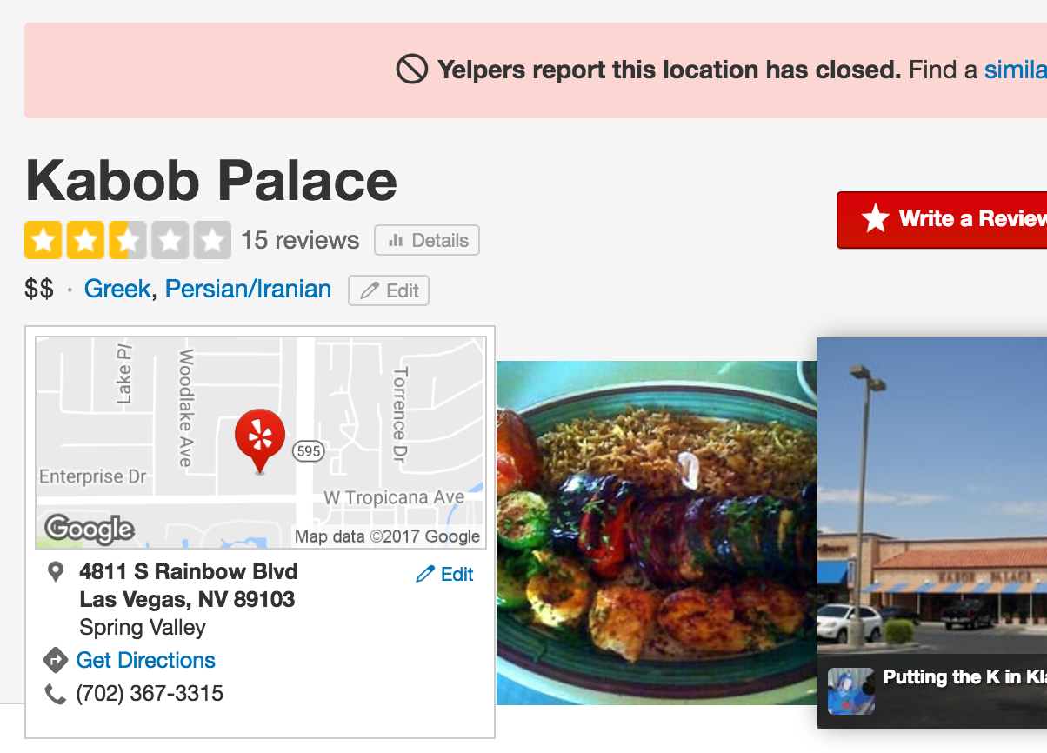

Slide 24
Voting Classifier in Work
Presto Calzone Bakery
Dessert, 138 reviews, 4.5 stars
Predicted open

Slide 25
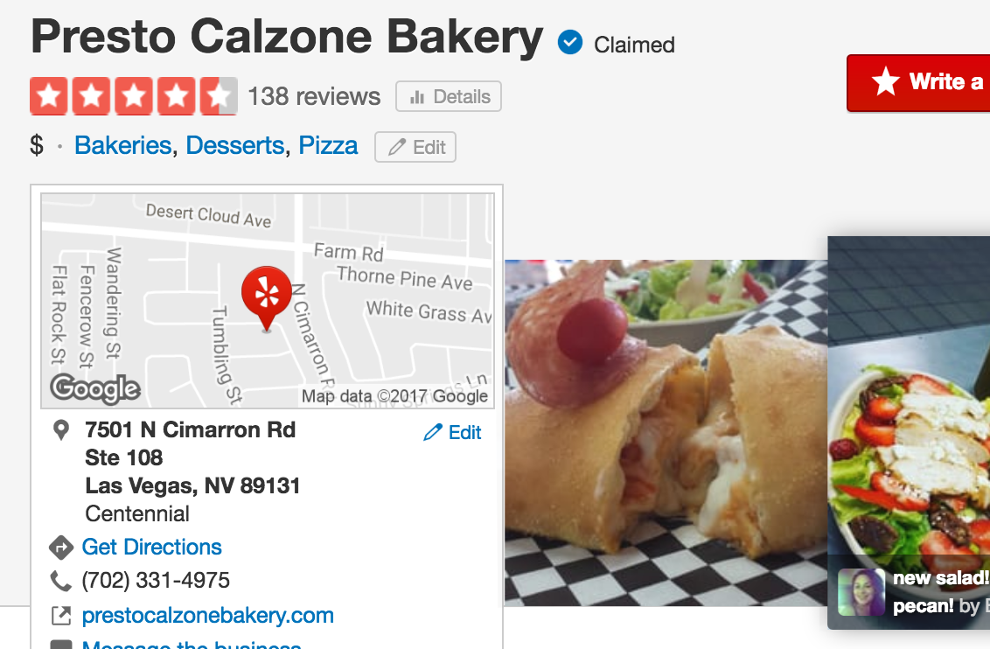

Slide 26
Voting Classifier in Work
Bailey's Sports Bar & Eatery
Sports bar, 9 reviews, 3.5 stars
Predicted open

Slide 27
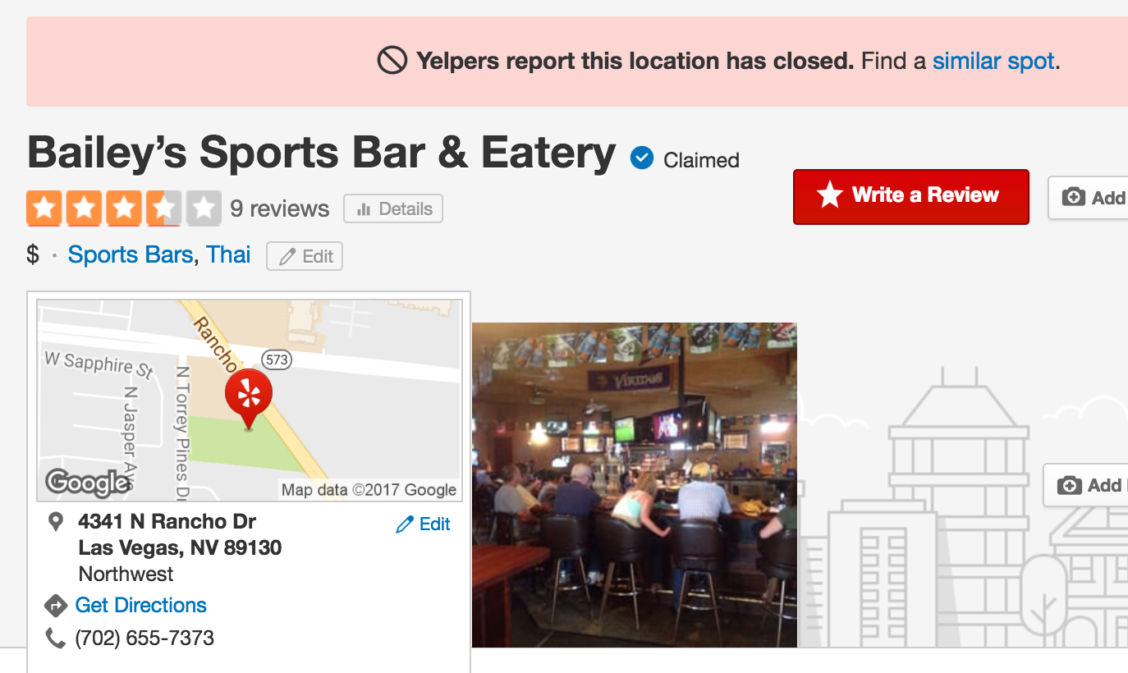

Slide 28
Implications - Logistic Coefficients
Review counts +
Is downtown +
Free Wifi +
Take out + and reservation -
Dessert and breakfast +
Ambience casual -
romantic , classy, hipster, etc +
Fast food, nightlife, pizza, sandwich, mexican +

Slide 29
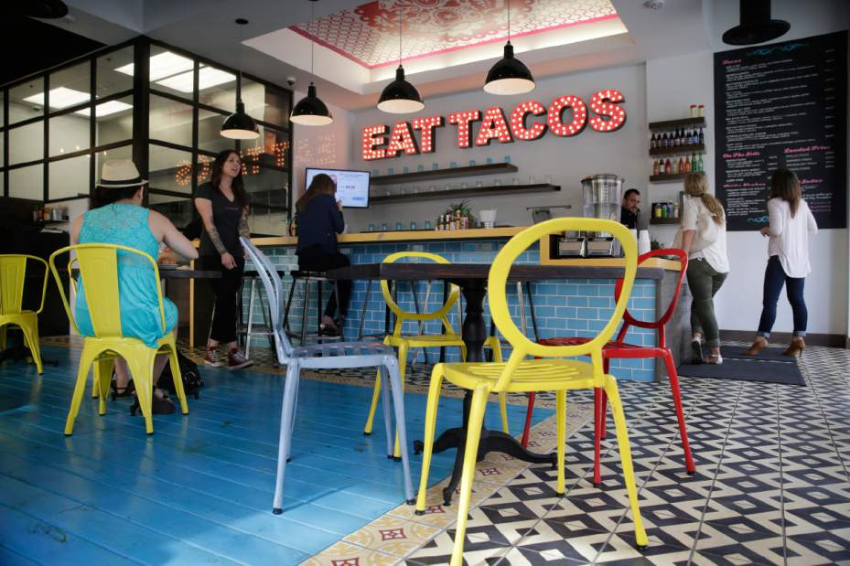
“Let’s open a hipster fast food place located in downtown Las Vegas, offers milkshake as dessert and hang a huge sign of “FREE WIFI” by the door!”

Slide 30
Future Work
Interactive Visualization
Other features
NLP of Yelp Reviews
Different cities
Submit to Yelp Challenge

Slide 31
Supporting Slides - Logistic Coef
['review_count', 1.6796259633553636, 'stars', 0.016046647841766223, 'RestaurantsPriceRange2S', -0.0014136174164024096, 'RestaurantsGoodForGroups', -0.083467014425517086, 'RestaurantsTakeOut', 0.065855273898838426, 'GoodForKids', -0.038559377744888455, 'RestaurantsAttire', -0.10130848270734759, 'RestaurantsReservations', -0.24019537125987675, 'OutdoorSeating', -0.12651453293793954, 'RestaurantsDelivery', -0.025117876085646765, 'Alcohol',
-0.15532795290311166, 'HasTV', 0.029384740555112795, 'is_dt', 0.028278272264585916, 'noise_loud', 0.011457301706683194, 'quiet', -0.086452768420441709, 'wifi_free', 0.20254911100867978, 'wifi_paid', 0.009279141818524626, "'dessert': True", 0.15070107352726309, "'latenight': True", 0.078410448220778264, "'lunch': True", 0.070398532275563225,
"'dinner': True", 0.081619680299880065, "'breakfast': True", 0.12530781487762088, "'casual': True", -0.17424131573673546, 'Nightlife', 0.21342636330047504, 'Bars', 0.022050521323724131, 'Fast Food', 0.5544480101861643, 'Burgers', -0.046353880363286561, 'Pizza', 0.17274839420009444, 'Chinese', 0.065623140621783635, '
Mexican', 0.15478972866888965, 'Japanese', -0.066051049211714508, 'Italian', -0.092850110952429468, 'Sandwiches', 0.1668041807049824, 'Seafood', 0.05278048044085866, 'Breakfast & Brunch', 0.028901964932381598, 'American', 0.0044602078270046686]

Slide 32
Supporting Slides - Algorithm Comparison
Accuracy | LR (L1) | LR (L2) | KNN | GNB | BNB | SVM | DT | RM
Best Out of Sample | 0.744 | 0.74 | 0.73 | 0.61 | 0.72 | 0.74 | 0.56 | 0.71
In Sample | 0.747 | 0.747 | 0.79 | 0.61 | 0.73 | 0.80 | 0.99 | 0.99

